Slide 1
10.2 Asymmetric Encryption and Hashing
Cryptography Day 2

Slide 2
Class Objectives
By the end of today’s class, you will be able to:
Calculate the required number of symmetric and asymmetric keys based on the number of people exchanging secure messages.
Use GPG to generate keys, and encrypt and decrypt private messages.
Use hashes to validate the integrity of data.
Use digital signatures to validate the authenticity of data.

Slide 3
Cryptography Review
‹#›

Slide 4
Activity: Cryptography Refresher
In the activities today, you will continue your role of security analyst at Hill Valley Police Department.
In this review activity, you must encrypt and decrypt a message using OpenSSL.
20 Minutes
‹#›

Slide 5
‹#›

Slide 6
Key Management and Exchange
‹#›

Slide 7
In the previous activity, we used symmetric key encryption. While its benefits include speed, efficiency and simplicity of use, symmetric encryption also has its disadvantages.
‹#›

Slide 8


Disadvantage One: Secure Key Exchange
As more individuals are included in the key exchange, there needs to be a key for each combination of individuals.
Offline Exchange (Out-of-Band Exchange)
Can include calling the recipient and reading the key, or mailing the key.
Diffie–Hellman Key Exchange
Uses complex mathematical principles to create a shared secret key between two parties over a public channel.
Notes:
AdobeStock_59056885 and AdobeStock_61123353

Slide 9





Disadvantage Two: Key Management
As more individuals are included in the key exchange, a key must be created for each combination of individuals.
Julie, Alice, Tim and Bob communicate using symmetric key exchange.
Julie
Julie
Julie
Alice
Alice
Tim
Key 1
Key 2
Key 3
Key 4
Key 5
Key 6
Alice
Tim
Bob
Tim
Bob
Bob
This is a small example. Since organization often need to securely communicate with large numbers of people, the amount of symmetric keys can quickly become overwhelming.
Notes:
shutterstock_567871777

Slide 10


Disadvantage Two: Key Management
Count of symmetric keys = (N * (N-1))/ 2
For an organization with 7 employees
For an organization with 1,000 employees
(7 * 6) / 2 = 42/2 = 21
(1000 * 999) / 2 = 499,500‬
Notes:
shutterstock_590381636

Slide 11
These disadvantages can be addressed with asymmetric key encryption.
‹#›

Slide 12
Asymmetric Key Encryptions
Each individual possesses a two-key pair:
Private keys are kept secret and can affect confidentiality of messages if exposed.
Private Key
Public keys are public and accessible to all.
Public Key
Like symmetric keys, these public and private keys are typically a random alphanumeric string.
Notes:
Shutterstock_567871777; Icons picked up from Fintech 18.1

Slide 13
Asymmetric Key Encryptions
Scenario: Tim wants to send Julie his bank account number using asymmetric key encryption.
Private Key
Julie will have a public and a private key.
The public key is truly public, accessible on
Julie’s website.
Public Key
Notes:
shutterstock_567871777

Slide 14


Asymmetric Key Encryptions
Scenario: Tim wants to send Julie his bank account number using asymmetric key encryption.
Julie
LXFOPVEFRNHR#4&/j2
Public Key
Tim creates a plaintext message containing his bank account number.
Tim goes to Julie’s website, gets her public key, and uses it to encrypt his message.

Slide 15

Asymmetric Key Encryptions
Scenario: Tim wants to send Julie his bank account number using asymmetric key encryption.
Julie
LXFOPVEFRNHR#4&/j2
Public Key
Tim sends
the encrypted message to Julie.
This can be sent over email or Slack without fear of interception.
The message can only be decrypted by Julie with her matching private key.

Slide 16

Asymmetric Key Encryptions
Scenario: Tim wants to send Julie his bank account number using asymmetric key encryption.
LXFOPVEFRNHR#4&/j2
Bank
Account
#
Private Key
Julie receives Tim’s encrypted message and decrypts it using her matching private key.
Julie can now see Tim’s bank number.
Notes:
AdobeStock_301805285_tablet

Slide 17

Key Management
While symmetric key count grows exponentially larger as the number of employees increase, asymmetric count stays proportionate and manageable with increases.
For a company with twelve employees:
Symmetric
Asymmetric
(N * (N-1))/ 2
(12 * 11) /2 = 66
N * 2
(12 * 2) = 24

Slide 18
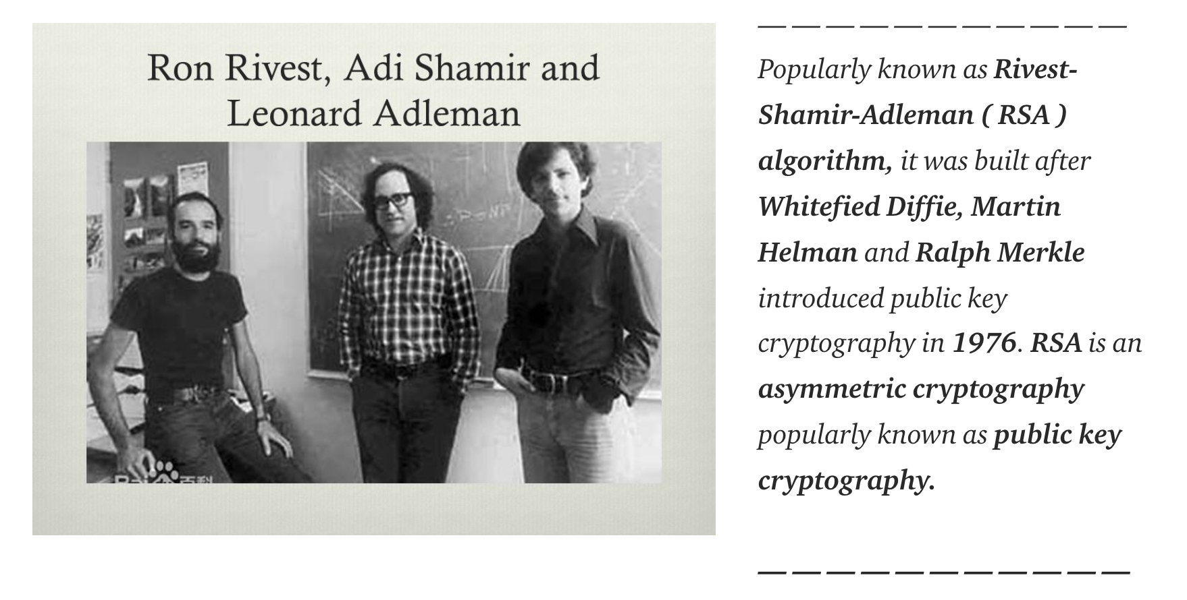
RSA
Asymmetric encryption uses an algorithm called RSA, introduced in 1977 and named after the last names of its creators.
(Source: Devyani Vij, Medium)

Slide 19

RSA is the asymmetric algorithm standard used around the world. It works by employing the complexity of factoring large prime numbers.
‹#›

Slide 20
[Optional] Activity: Optimizing with Asymmetric Public Keys
In this activity, you will compare the key counts required for communicating with asymmetric and symmetric key cryptography.
Complete if class falls on Saturday
‹#›

Slide 21
‹#›

Slide 22
Applying Public Key Cryptography with GPG
‹#›

Slide 23

GNU Privacy Guard (GPG)
GPG is a command-line tool used to simplify the creation, encryption, and decryption of asymmetric key cryptography.
GPG is a free program, available on many Linux distributions, that runs symmetric and asymmetric encryption algorithms.

Slide 24
In the following demonstration, we will use the bank account scenario with GPG to create a key pair for asymmetric encryption and decryption.
‹#›

Slide 25
GPG
‹#›

Slide 26
Activity: GPG
In this activity, you will use asymmetric encryption with GPG to encrypt and decrypt text files.
20 Minutes
‹#›

Slide 27
‹#›

Slide 28

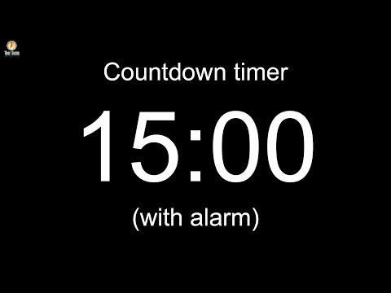
Notes:
Image source: AdobeStock_56885471

Slide 29
Hashing and Data Integrity
‹#›

Slide 30
So far, we’ve used cryptography to protect privacy and confidentiality. It can also be applied to protect the integrity of data.
‹#›

Slide 31
Hashing
Hashing is a cryptographic method used to verify the integrity of data.
Similar to encryption, hashing uses algorithms to input data and generate a unique output.
MD5
I Love
Cryptography!
676e4bff90a76853b da00773f7ad4bed
While this looks similar to cryptography, we’ll see that there are several significant differences.

Slide 32

Difference One: Keys vs. No Keys
Encryption takes plaintext and converts it to ciphertext with a key and an algorithm.
LXFOPVEFRNHR#4&/j2
Encryption Key
Decryption Key
Plaintext
Encrypted Text
Plaintext
Hashing takes plaintext and converts it to a message digest with an algorithm, and no key.
LXFOPVEFRNHR#4&/j2
Plaintext
Hash Function
Hashed Text
‹#›

Slide 33

Difference One: Keys vs. No Keys
Message digests are also known as fingerprints, hashes, and checksums.
They are unique identifiers of the plaintext that are outputted from the algorithm. For example:
676e4bff90a76853bda00773f7ad4bed
‹#›
Notes:
shutterstock_765048736

Slide 34

Difference Two: Reversible vs. Irreversible
Encryption converts ciphertext and plaintext back and forth using encryption and decryption.
“I Love Cryptography!”
676e4bff90a76853bda00773f7ad4bed
Plaintext
Hash Function
Hashed Text
Hashing is a one-way function, meaning it cannot be converted back to plaintext.
‹#›

Slide 35
Difference Three: Output Lengths
Hashing algorithms output fixed lengths. Regardless of the input length, the output length is always the same.
#
I Love Cryptography!
676e4bff90a76853bda00773f7ad4bed
#
Hi
c1a5298f939e87e8f962a5edfc206918
We hold these truths to be self-evident, that all men are created equal, that they are endowed by their Creator with certain unalienable Rights, that among these are Life, Liberty and the pursuit of Happiness...
#
124650d689d47f777f715a25260a29c2
This is the hash of the entire Declaration of Independence!
‹#›

Slide 36

Difference Four: Goals
Encryption’s main goal is privacy.
Hashing’s main goal is integrity.
‹#›
Notes:
AdobeStock_286685511

Slide 37
Difference Four: Goals
If a small change is made to the input of a hashing algorithm, the message digest is completely different.
I Love Cryptography! = 676e4bff90a76853bda00773f7ad4bed
I Love Cryptography!! = 4e6fc433ff57a6c4a854cbbeff65f61a
I Love Cryptography? = d7a5035b338b66bf7f50dc85dbf1a279
I Luv Cryptography! = ad7e7b47b58e28a2894f5fcf9dc41691Ω
‹#›

Slide 38

Hashing Algorithms
Hashing has several algorithms:
SHA
stands for Secure Hashing Algorithms, and includes its successors, SHA1 and SHA2.
MD
stands for Message Digest and has several variations: MD2, MD4, and MD5.
SHA2
has variations with different security strengths: SHA-256 and SHA-512.
LM and NTLM
are hashes used by Windows.

Slide 39
Creating Hashes on the Command Line
‹#›

Slide 40
Activity: Generating Hashes
In this activity, you will verify the integrity of files by generating hashes of current and backup files, and then comparing them.
17 Minutes
‹#›

Slide 41
‹#›

Slide 42
Digital Signatures
‹#›

Slide 43
Cryptography can also be used to validate authenticity using digital signatures.
‹#›

Slide 44
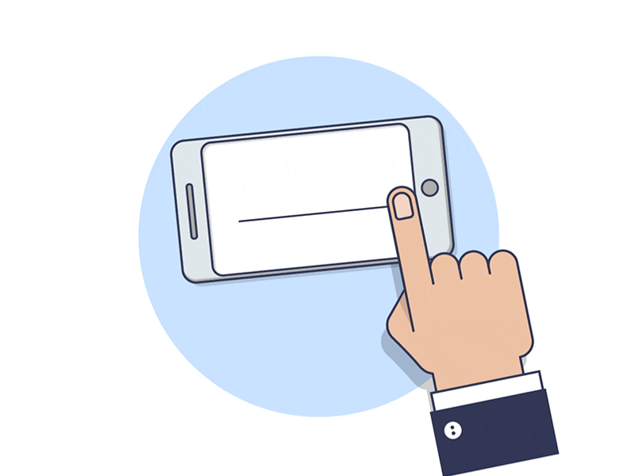
Digital Signatures
A digital signature is a mathematical scheme used to verify the authenticity of digital data.
In the United States and several other countries, digital signatures are considered legally binding.
Similar to asymmetric encryption, digital signatures also use public key cryptography.
However, digital signatures use public and private keys in reverse.
(Source)
‹#›
Notes:
https://dribbble.com/shots/4545821-Signature-Tutorial

Slide 45
Digital Signatures
Scenario: Tim wants to send Julie a message that says “Transfer $500 to the account I provided to you,” and then digitally sign the message.
STEP 1
Key Creation
Tim will have a public and a private key.
The public key is truly public, and accessible on his website.
Private Key
Public Key
‹#›

Slide 46

Digital Signatures
Scenario: Tim wants to send Julie a message that says “Transfer $500 to the account I provided to you.” and then digitally sign the message.
STEP 2
Creating the Message
Tim places his message inside a file.
Transfer $500 to the account.
Tims_message.txt
‹#›

Slide 47

Digital Signatures
Scenario: Tim wants to send Julie a message that says “Transfer $500 to the account I provided to you.” and then digitally sign the message.
STEP 3
Signing the Message
Tim signs the message with his private key in order to create a digital signature.
Tim
Transfer $500 to the account.
Private Key
Tims_message.txt
Digital Signature
‹#›

Slide 48
Digital Signatures
Scenario: Tim wants to send Julie a message that says “Transfer $500 to the account I provided to you.” and then digitally sign the message.
STEP 4
Sending the Message
Tim sends the digital signature to Julie along with his plaintext message.
Transfer $500 to the account.
Private Key
‹#›

Slide 49


Digital Signatures
Scenario: Tim wants to send Julie a message that says “Transfer $500 to the account I provided to you.” and then digitally sign the message.
STEP 5
Validating the Signature
Julie uses Tim's public key to validate the signature, using a validation tool such as GPG.
Transfer $500 to the account.
Private Key
Tim
‹#›

Slide 50
That scenario depicted a detached signature, in which the message and the signature are sent separately.

Slide 51
Digital Signatures
Other digital signatures include:
All at Once
A signature appended to an encrypted message.
Clearsigned
A signature appended to an unencrypted message.
Signed Hash
Instead of signing a message, a hash is created first and the hash is signed for verification.
‹#›

Slide 52
In the next demo, we will apply a detached digital signature with GPG.
‹#›

Slide 53
Signing with GPG
‹#›

Slide 54
Activity: Digital Signatures
In this activity, you will use GPG to determine the authenticity of messages.
20 Minutes
‹#›

Slide 55
‹#›

Slide 56
Any Questions?
‹#›

